Slide 1


Capstone Project
Data Analysis
By - Rishabh Kumar Yadav

Slide 2

Agenda
Business Model
Data Summary
Host listing in different neighbourhood group
Best tourist place in neighbourhood group
Increase in guest & hosting over the years
Average guest as per room hosted in neighbourhood group
Room type preferred by tourist
Average price of room type in neighbourhood group
Average night stayed by tourist in different room type
Max room type hosted
Area preferred by tourist in Brooklyn
Peak month of tourist visit in Brooklyn
Avg. availability of room in neighbourhood group
Top 10 host with max listing in 2019
Top 10 host with max reviews in 2019
Scope of areas to increase business

Slide 3
Data Summary
Id :- Unique ID
Name :- Property description
Host ID :- Unique host ID
Host Name :- Name of the host
Neighbourhood Group :- Different location in New York
Neighbourhood :- Different area in different location of New York
Latitude :- Latitude range
Longitude :- Longitude range
Room type :- Type of room listed
Price :- Price of different room type
Minimum Night :- Minimum nights to be paid for
Number of reviews :- Total number of reviews as per hosting list
Last reviews :- date of last reviews
Reviews per month :- Average reviews per month
Calculated host listing count :- Total count of hosting as per hosting list
Availability 365 :- Number of days property available in a year

Slide 4
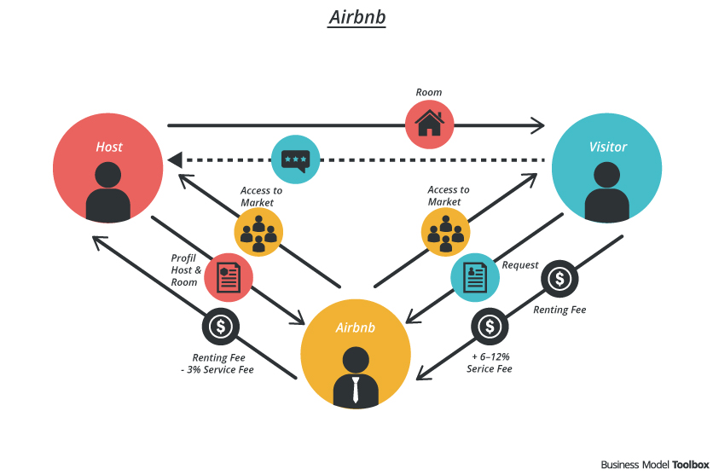
Business Model
“feel at home anywhere you go in the world”
Airbnb is a community-based, two-sided online platform that facilitates the process of booking private living spaces for travelers. On the one side it enables owners to list their space and earn rental money. On the other side it provides travelers easy access to renting private homes.
Mission & Core Values:
Airbnb is more than an affordable travelling accommodation option. Through facilitating access to distinctive spaces and local culture, Airbnb aims to enable travelers to “feel at home anywhere you go in the world” by building connections with local hosts, gaining access to distinctive spaces and culture of their destinations.
Value Formation & Core Activities
Airbnb operates as a transaction facilitator between hosts and travelers who are looking for comfortable accommodation at a cheap price. By providing host protection insurance, as well as a rating and review system, the platform builds trust within the community of users and lowers transaction costs.
Revenue Model
Airbnb receives commissions from two sources upon every booking, namely from the hosts and guests. For every booking Airbnb charges the guest 6-12% of the booking fee. Moreover Airbnb charges the host 3% for every successful transaction.

Slide 5
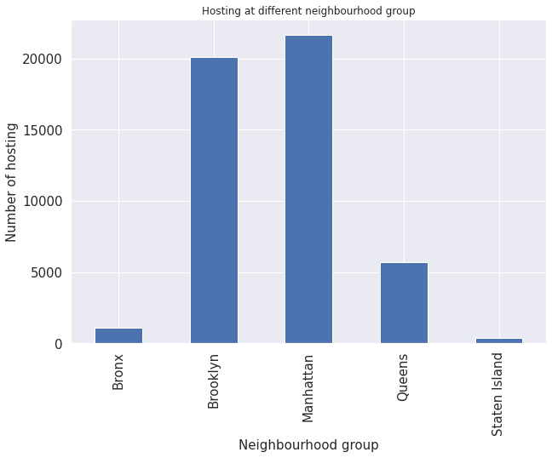
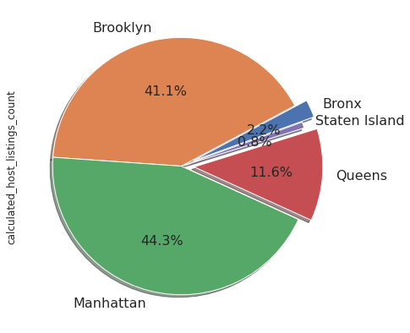
Host listing in different neighbourhood groups
Manhattan has the height number of hosting of 21661 and followed by the Brooklyn of 20104.
Queens has the third height listing with 5666 .
Bronx & Staten Island has the least number of hosting.

Slide 6
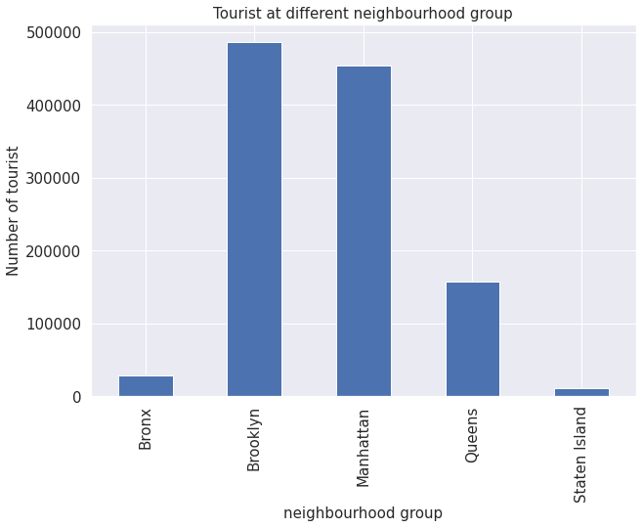
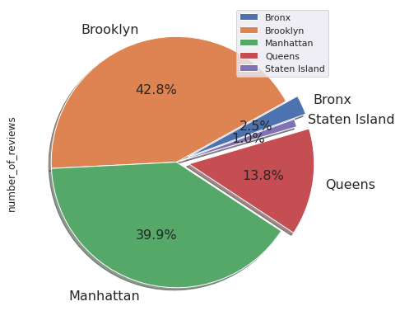
Best tourist place in neighbourhood group
Brooklyn is best tourist destination with the tourist of about 486000 and followed by Manhattan with tourist of 454000.
Queens has the third height tourist with 15600 of tourist but in comparison to Brooklyn & Manhattan it is extremely low.

Slide 7
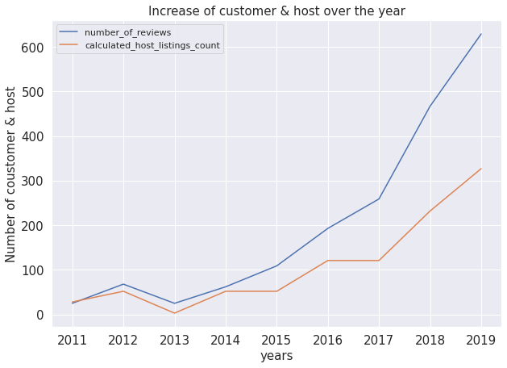
Increase of guest & host over the year
In 2017 to 2019 maximum number of reviews has increased from 260 to 600+ which clearly shows that number of guest acquisition has rapidly increased from 2017.
Host listing has also increased from 120 to 300+ over the year from 2017 to 2019

Slide 8
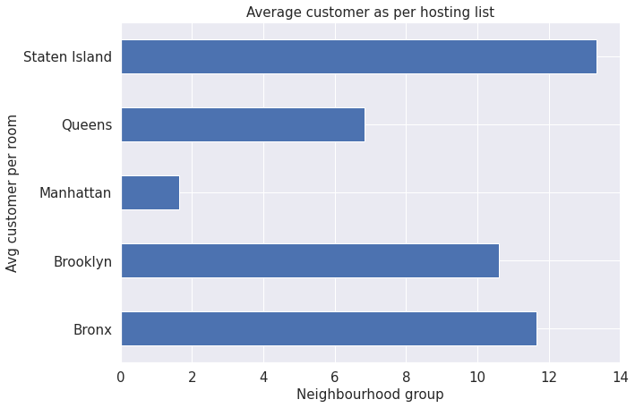
Average guest as per hosting list
Bronx & staten Island has the height average of guest as per the room hosted in different neighbourhood groups.
Brooklyn being a best tourist place and having a average guest of 11 per room shows that it required more number hosting in Brooklyn.

Slide 9
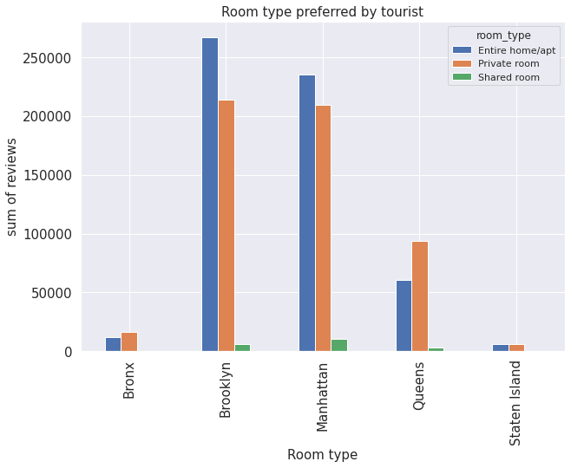
Room type preferred by tourist
In Brooklyn & Manhattan tourist used to prefer more entire home/apartment and relatively private rooms too.
Shared room type is not preferred by tourist in any neighbourhood groups.
In Queens private rooms are more preferred than entire home/apartments.

Slide 10
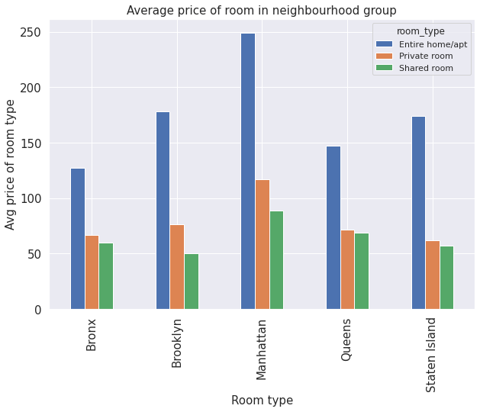
Average price of room type in neighbourhood group
Average price range of entire home/apt is from 127 to 249 USD in different neighbourhood group.
Average price range of private room is from 62 to 116 USD in different neighbourhood group.
Average price range of shared room is from 50 to 69 USD in different neighbourhood group

Slide 11
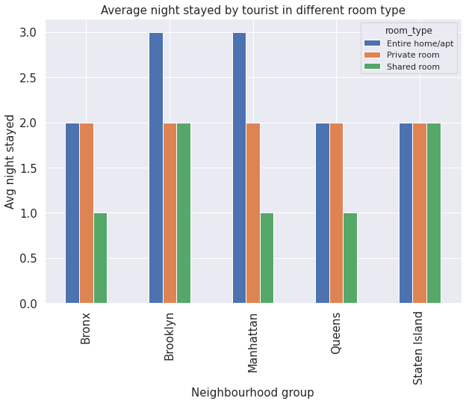
Average night stayed by tourist in different room type
Average night stayed by the tourist is approx 2 to 3 days in Brooklyn & Manhattan
In Bronx,Queens,Staten Island average night stayed by the tourist is 2 to 1 days
Maximum tourist likes to stay in Brooklyn & Manhattan.
Tourist mostly like to stay in entire house/apt or private room

Slide 12
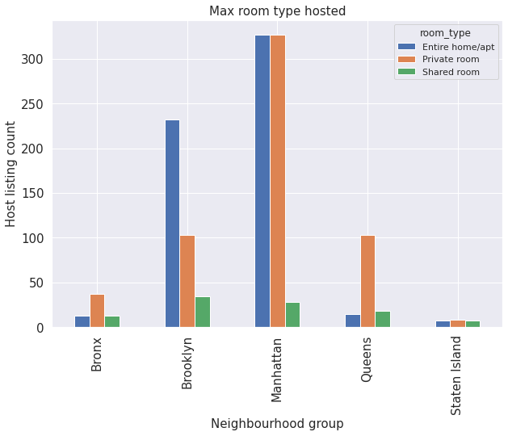
Max room type hosted
Maximum room are hosted in Manhattan in which entire home/apt and private rooms are hosted near to about 300+
Brooklyn has the second height hosting in which entire home/apt has the height hosting of about 230 and private rooms are near about 100
Shared room are relatively listed very low compared to other room type.

Slide 13
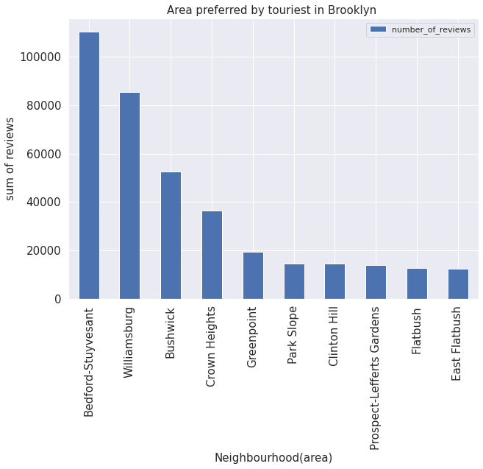
Area preferred by tourist in Brooklyn
Bedford,Williamsburg,Bushwick,Crown heights these 4 areas are been mostly preferred by tourist to stay in Brooklyn.
conclusion
In these 4 areas we need to increase host listing in these areas to acquire more guests in Brooklyn.

Slide 14
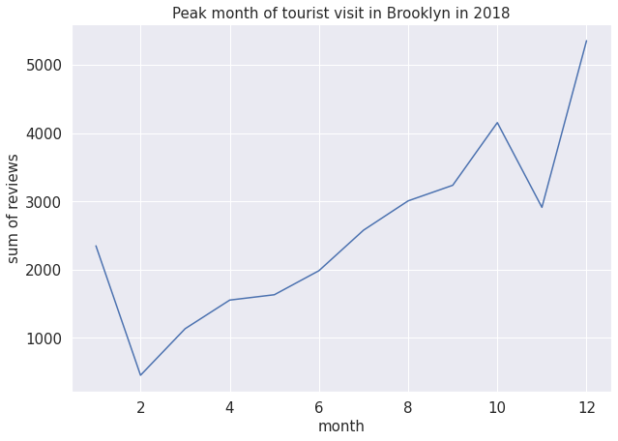
Peak month of tourist visit in Brooklyn
Tourist visit is high in last 4 months of the year in Brooklyn with the increase of number of reviews by 3000 to 5000+.
Conclusion
In last 4 month of the year we can increase the hosting list or we can increase the availability of room during these periods in brooklyn .

Slide 15
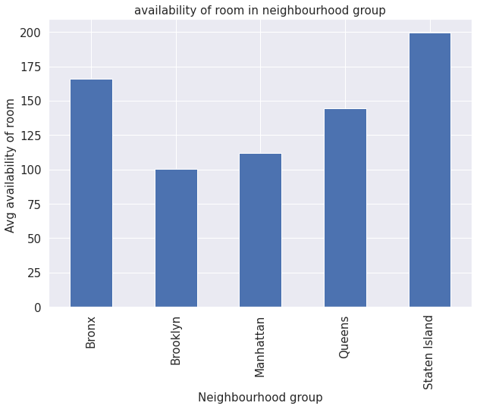
Avg. availability of room in neighbourhood group
In Bronx & Staten Island has the highest availability of room throughout the year
In Brooklyn average availability of rooms are very least compared to other neighbourhood groups.
Conclusion
In Brooklyn we need increase the availability of rooms during peak month of tourist.

Slide 16
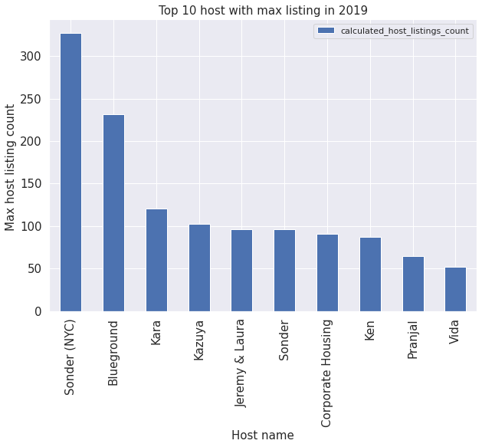
Top 10 host with max listing in 2019
These are the top 10 hosts who has hosted there property maximum number of time during the year 2019.
Conclusion
By recognizing top 10 host with maximum number of hosting and appreciating them through gifts,vouchers or anything which can motivate other hoster to also host there property more number of times.so that the availability of room can be increased to acquire more guests.

Slide 17
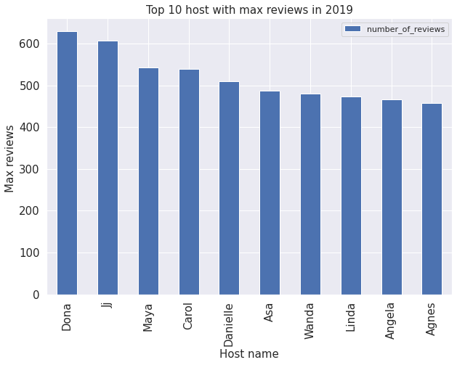
Top 10 host with max reviews in 2019
These are the top 10 hosts with maximum number of reviews during the year 2019.
Conclusion
By recognizing top 10 host with maximum number of reviews and appreciating them through gifts,vouchers or anything which can motivate other hoster to also provide the best service to their guests because they are the face of the company.

Slide 18
Scope of areas to increase business
Brooklyn & Queens are the 2nd & 3rd highest hosting listed in different neighborhood areas.
Brooklyn is best tourist destination with the tourist of about 486000 & Queens has the third height tourist with 15600 of tourist but in comparison to Brooklyn it too less.
Brooklyn being a best tourist place and having an average guest of 11 per room shows that it required more number hosting in Brooklyn.
In Brooklyn room type preferred by tourist are entire home/apartments or private room.
Average price range of room in Brooklyn are 50 to 178 USD
Average night stayed by the tourist is approx. 2 to 3 days in Brooklyn
Brooklyn has the second highest hosting in which entire home/apt has the highest hosting of about 230 and private rooms are near about 100.

Slide 19
Scope of areas to increase business
In these areas Bedford, Williamsburg, Bushwick, Crown heights we need to increase host listing in these areas to acquire more guests in Brooklyn.
In Brooklyn average availability of rooms are very least compared to other neighborhood groups.
In last 4 month of the year we can increase the hosting list or we can increase the availability of room during these periods in Brooklyn.
By recognizing top 10 host with maximum number of hosting and appreciating them through gifts, vouchers or anything which can motivate other hoster to also host their property a greater number of times.so that the availability of room can be increased to acquire more guests.
By recognizing top 10 host with maximum number of reviews and appreciating them through gifts, vouchers or anything which can motivate other hoster to also provide the best service to their guests because they are the face of the company.

